Slide 1
Remote Respiratory Rate and Heart Rate Evaluation
03NOV21
Rahul Ragunathan
Miguel Mireles

Slide 2

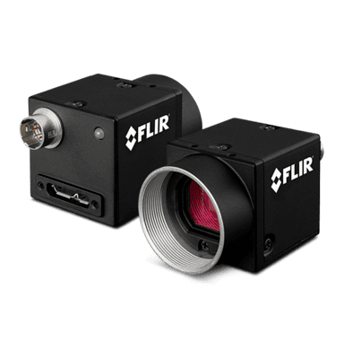
System and Analysis Overview
Image Acquisition
Region of Interest Selection
Digital Signal Processing
Structure Sensor (Occipital ST01) Source:
830 nm
Blackfly U3-28S5M Detector:
7.5 HZ , 12 bit depth ADC
2 ROI are chosen:
Face🡪 Heart Rate
Chest/Abdomen🡪 Respiratory Rate
Basic mask applied based on statistics
Combination of Cascade Detectors / KLT for tracking
Average over ROI to generate time series
Empirical Mode Decomposition(EMD)🡪 Denoising/Detrending
Bandpass Filter

Slide 3
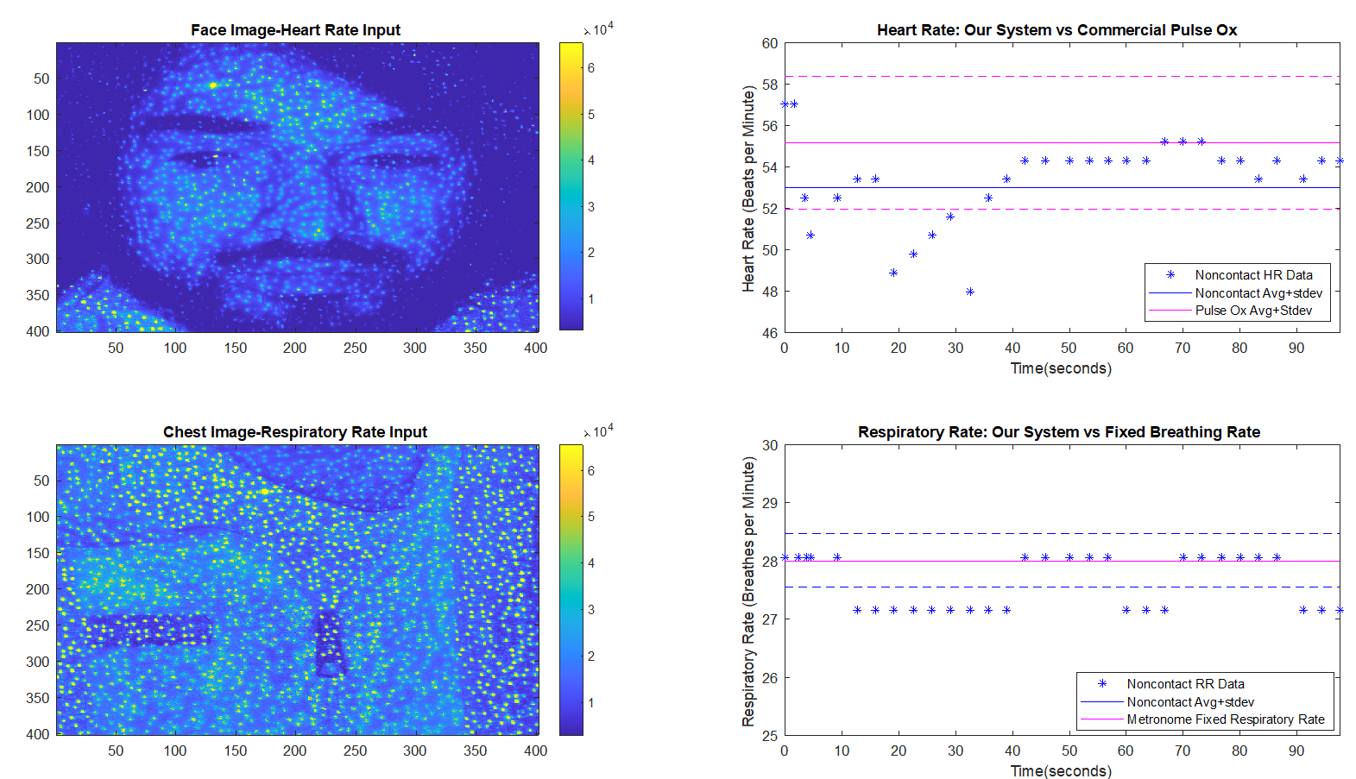
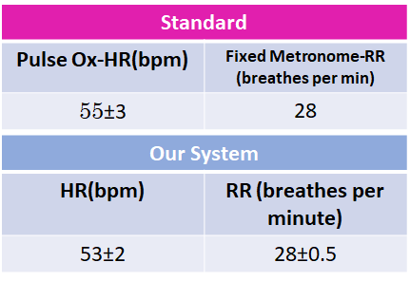
Data Overview

Slide 4
Constraints and Future Directions
Constraints:
Sensitive to motion artifacts-Image stabilization
Very sensitive to pose
Respiratory Rate ROI (chest) is highly sensitive to conditions of exposure (sweaters, jackets, blankets, etc)
Future Directions:
Multiwavelength sources/Thermal cameras can allow for just face ROI based approaches –Less sensitivity to noise
Increasingly sophisticated algorithmic approaches (PCA, CHROM, PBV, MLSVD etc)

